Slide 1
SHOP
Comprehensive Development of an E-Commerce Platform

Slide 2
TEAM MEMBERS
PAY
NAME | SCHOOL ID
Osama naaz | 11801087
Jaswanth | 11771147
Nirupama | 11810487
Niharika | 11810493
harini | 11821595
Triveni | 11811560
Sharanya | 11800811
Rajsekhar | 11693961

Slide 3
Executive Summary
This project outlines the development of a scalable e-commerce platform in three distinct phases.
Phase 1: Established the foundation with authentication, product catalog, and basic search and recommendation.
Phase 2: Enhanced interactivity with dynamic cart management, secure payment integration, and order tracking.
Phase 3: Focused on user engagement with real-time notifications, discount systems, and advanced analytics.
By following an iterative approach, each phase expanded the platform’s functionality while addressing feedback and technical challenges.

Slide 4
Phase 1 Overview – Core Feature Development
Objective: Lay a strong foundation by implementing the most essential e-commerce functionalities.
User Authentication: Developed secure login, registration, and password management systems with email verification.
Product Catalog: Displayed products in categorized grids with basic filters for better user navigation.
Search Functionality: Introduced keyword-based search to help users locate products efficiently.
Initial Recommendation System: Implemented a basic collaborative filtering algorithm to suggest relevant products.
Responsive Design: Ensured compatibility with different devices, focusing on mobile-first usability.

Slide 5
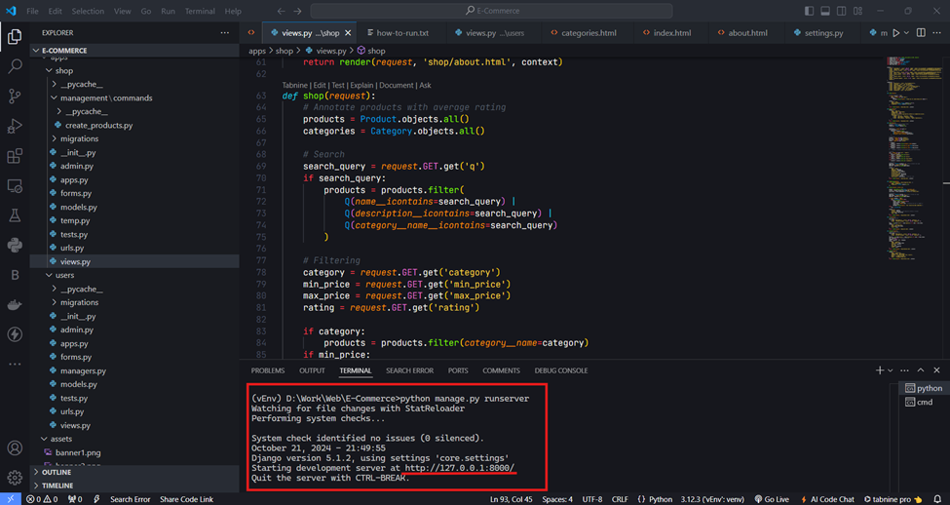
Fig 1 Project Setup
Examined the project's progress from the time the clone was created from the repository until the server booted up.
Made sure the program is available at http://localhost:8000.and operates without any issues. As illustrated in Fig 1.

Slide 6
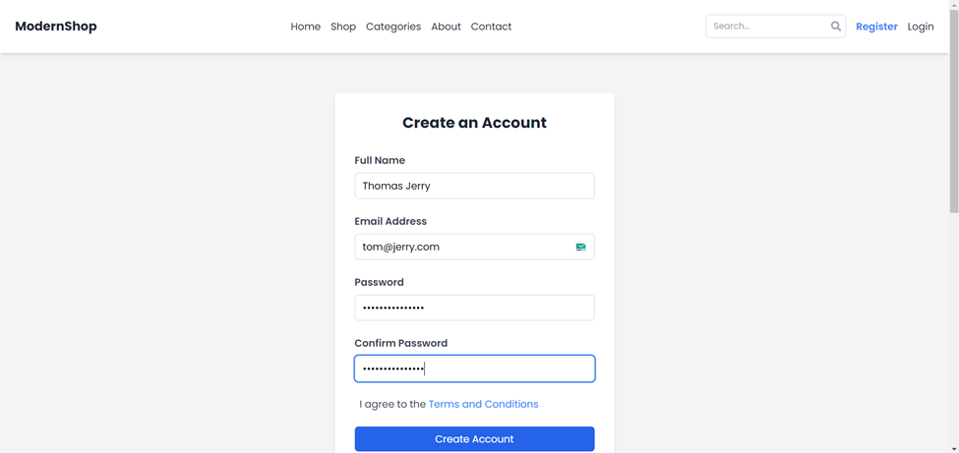
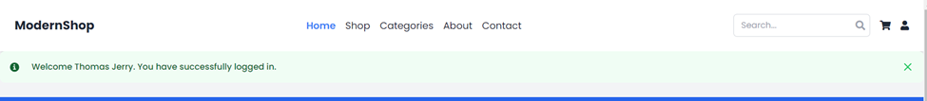
Fig 2 User Registration
Confirmed the implementation of new user signup.
Confirmed that the account creation process was successful, that the user was taken to the relevant page, and that the user could log in using their new login information.

Slide 7
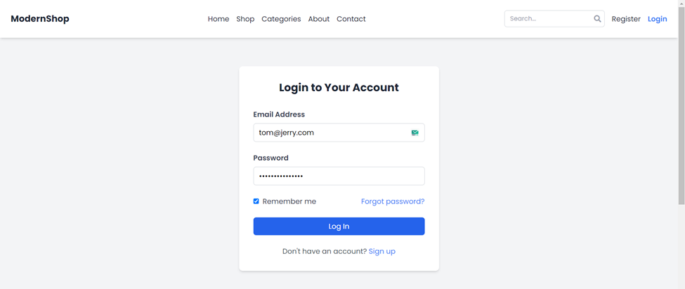
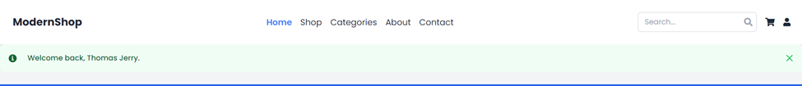
Fig 3 User Login
Enables the registration of new users and ensures their login.
Verified that the system had properly authenticated the user, forwarded the appropriate web pages, and presented user-specific content.

Slide 8
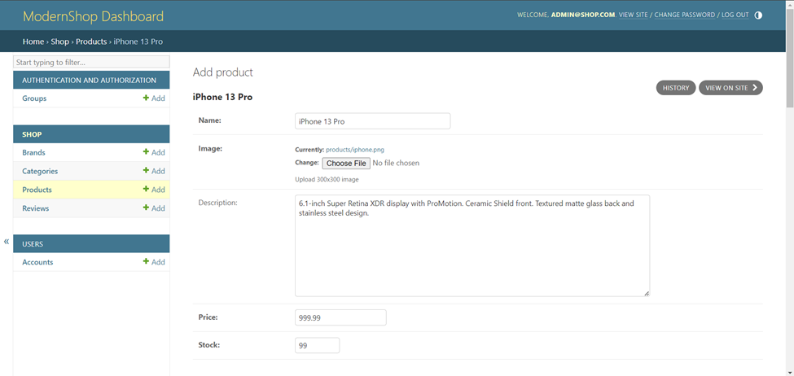
Fig 4 Product Addition
Confirmed that an administrator could use the admin interface to add new goods.
It determines if the product is listed in the admin panel and on the main website.

Slide 9
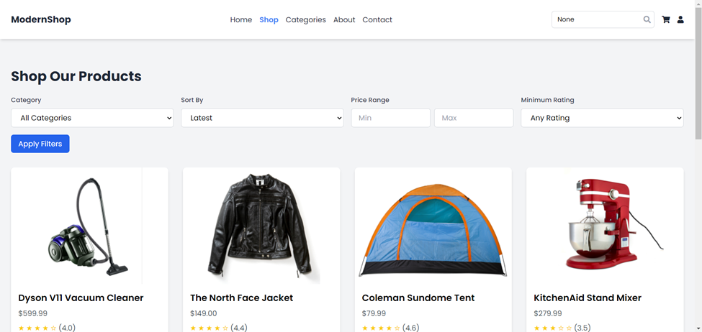
Fig 5 Product Listing
Confirmed that the products were shown correctly on the main index page.
Verified that the product pictures, names, and prices were shown correctly, among other things.

Slide 10
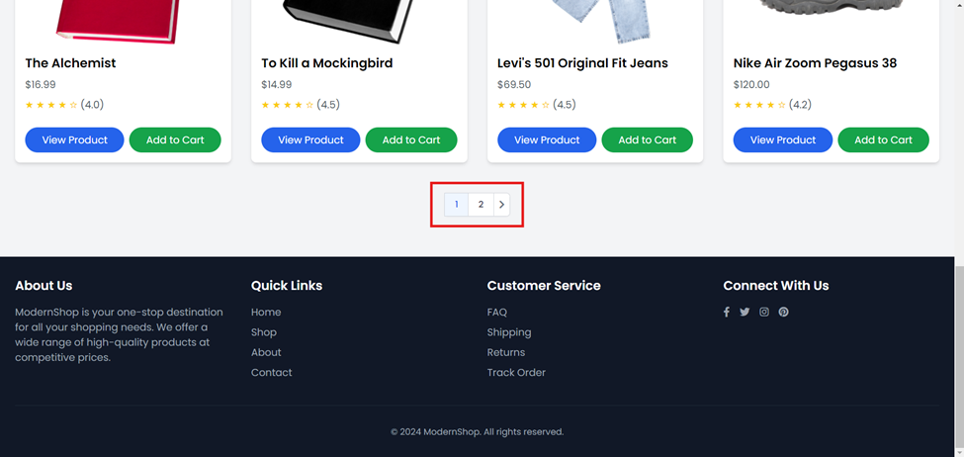
Fig 6 Product Pagination
Centered on product page management, which is typically utilized while creating new products.
Made sure the appropriate page transition and product were shown on each page.

Slide 11
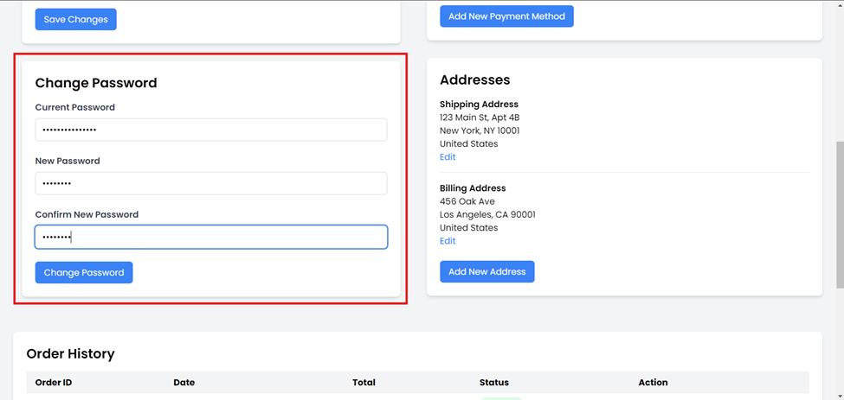
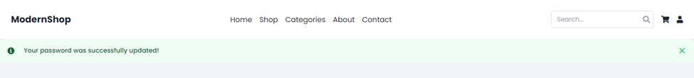
Fig 7 User Password Change
Confirmed the updated password worked and could be used to access the account on the website.

Slide 12
Phase 2 Overview – Core Feature Expansion
Objective: Enhance platform interactivity and ensure smooth user transactions for a complete shopping experience.
Dynamic Cart Management: Allowed users to modify cart contents dynamically, with real-time inventory updates.
Secure Payment Gateway Integration: Added support for Stripe and PayPal to handle transactions securely.
Order Tracking System: Enabled users to view detailed order statuses and track shipments in real time.
Address Management: Designed a feature for users to save and manage multiple shipping addresses securely.
Improved Recommendation System: Upgraded algorithms to offer real-time product suggestions based on browsing history.

Slide 13
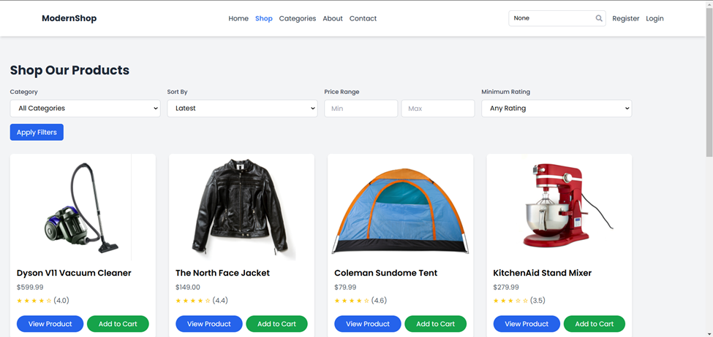
Fig 8 Browse Products
The ability to navigate to the product browsing page and correctly examine a list of products with their names, prices, and availability details is covered in this figure.

Slide 14
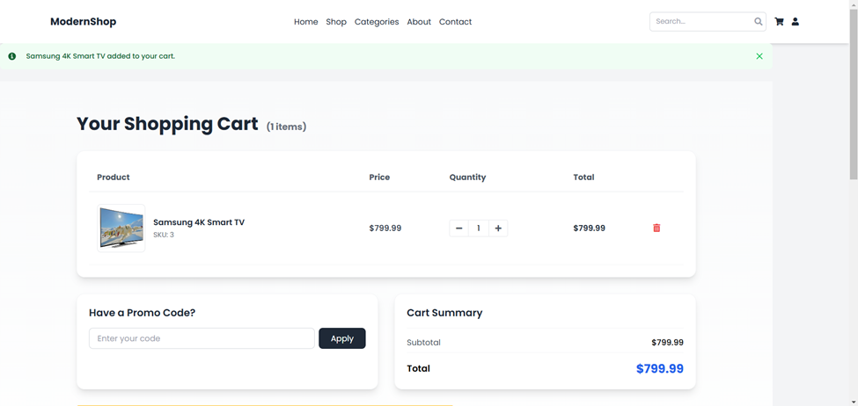
Fig 9 Add to Cart
When a user chooses a product and clicks "Add to Cart," this will ensure that the item is truly added to the shopping cart and that the cart's count is updated appropriately.

Slide 15
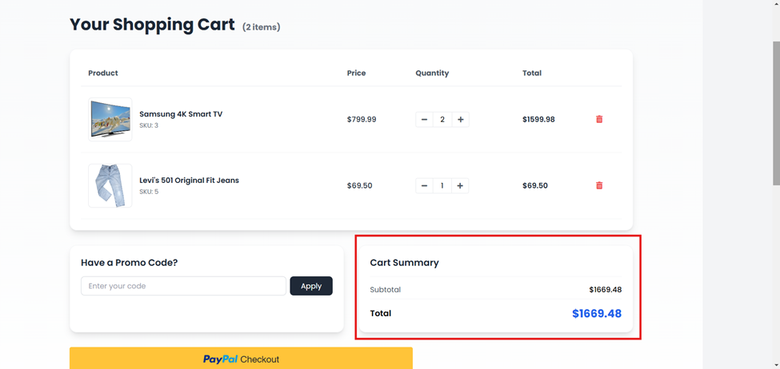
Fig 8 Compute Total
This guarantees that the base item pricing, taxes, and shipping charges are included in the checkout total cost to provide the accurate total value.

Slide 16
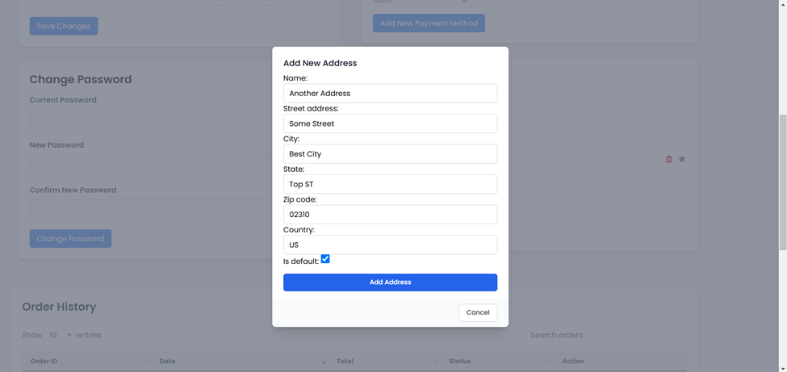
Fig 9 Save Address
When information is entered and the "Save" button is pressed, this section verifies that a new shipping address was recorded and that the address appears in the user's address book.

Slide 17
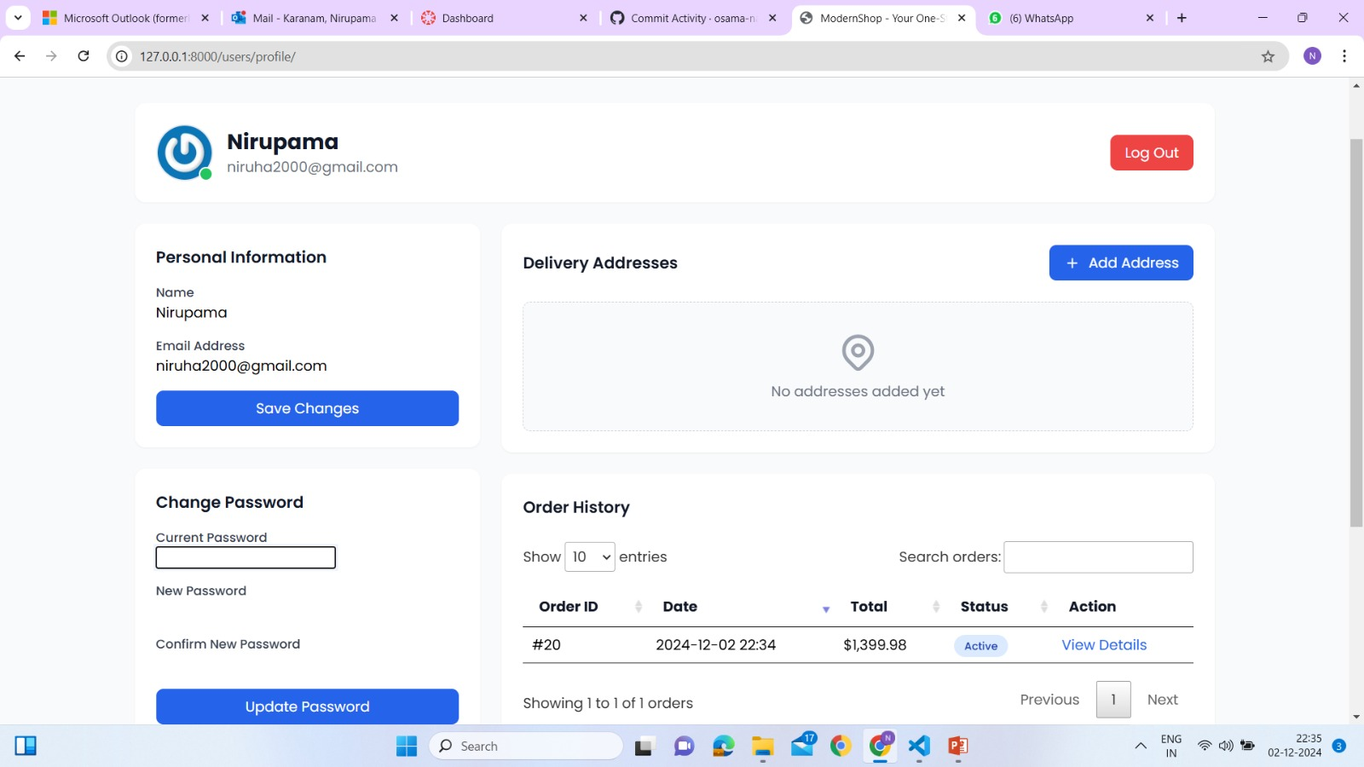
Fig 10 Payment Processed Successfully
This shows the items in cart before adding address yet to confirm and place the order

Slide 18
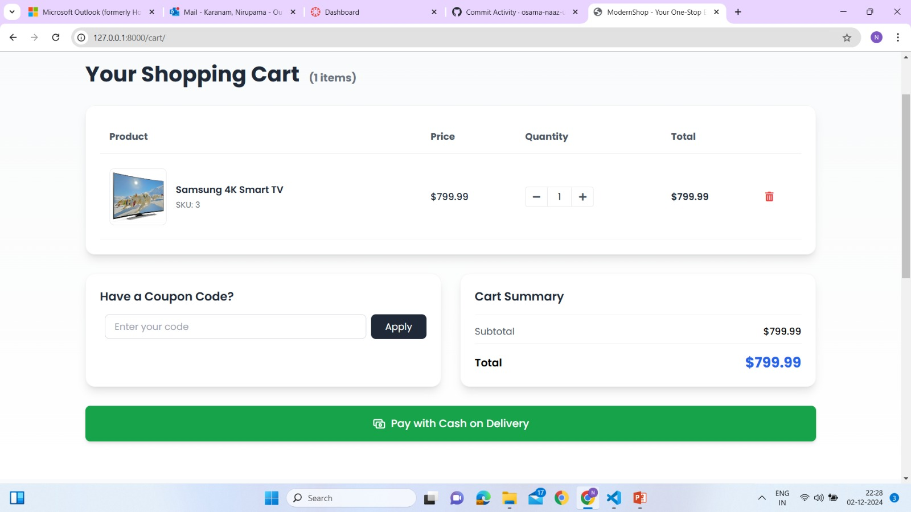
Fig 11 Payment Processing
This would confirm that the payment is on delivery and the user can continue with placing the order without doing the payment

Slide 19
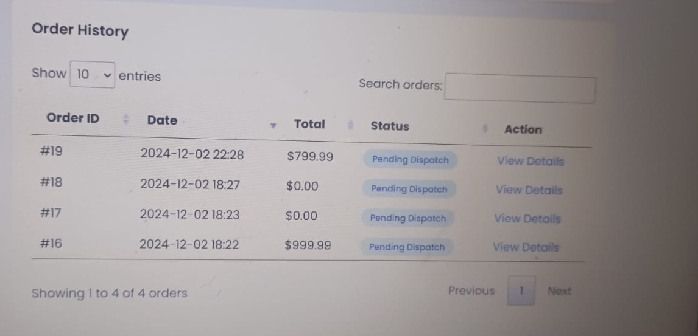
Fig 12 Track Order
In this section, a user can track down their order by going to the order tracking page, which displays the status of their order.

Slide 20
Phase 3 Overview – Secondary Feature Development
Objective: Focus on user engagement, system efficiency, and additional features for enhanced functionality.
Notification System: Added real-time notifications for order updates, promotional offers, and system alerts.
Discount and Coupon Features: Developed a coupon management system with backend validation for discounts.
Enhanced Order History: Provided sorting, filtering, and downloadable invoice options for user convenience.
Data Security Improvements: Strengthened data encryption and validated inputs to prevent cyber vulnerabilities.
Finalized Recommendation Engine: To implement economical algorithms to deliver smooth execution under high volume of data.

Slide 21
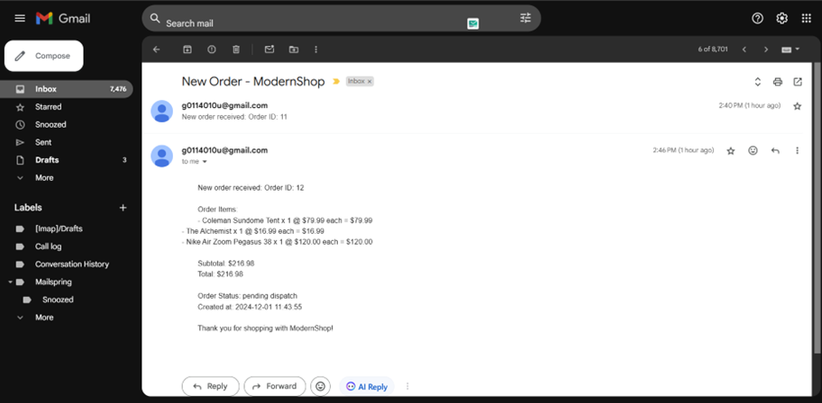
Fig 13 Notification and Email Functionality
Tested the system's ability to send notifications and emails (e.g., order updates).

Slide 22
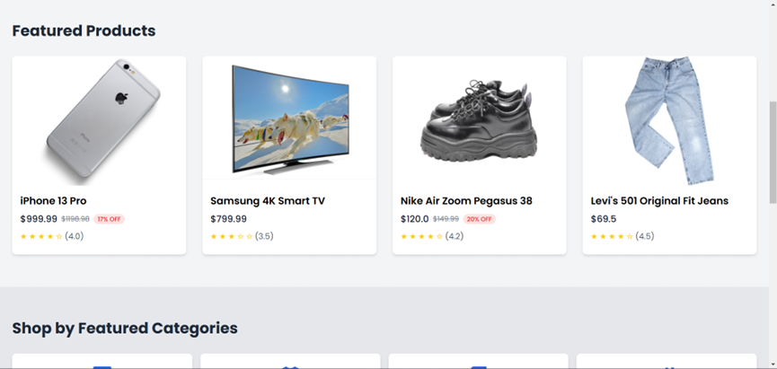
Fig 14 Discount and Coupons Functionality
Confirmed the usage of proper and improper coupons during the payment process.

Slide 23
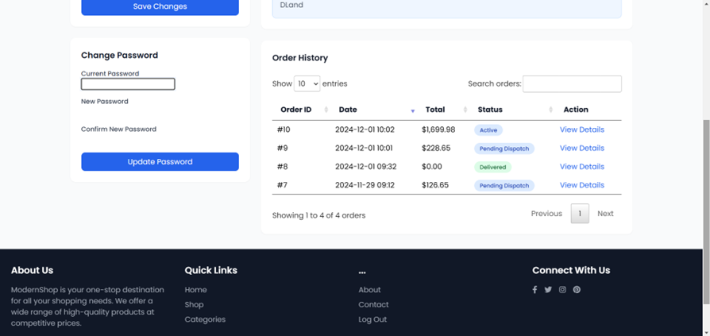
Fig 15 Order History Functionality
Made sure that user are able to track their past orders or previous purchases.

Slide 24
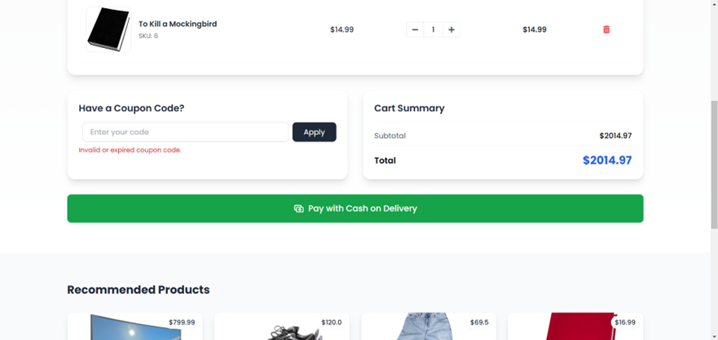
Fig 16 Data Validation and Security
Invalid coupon code prevention was among input validation and security practices that were examined.

Slide 25
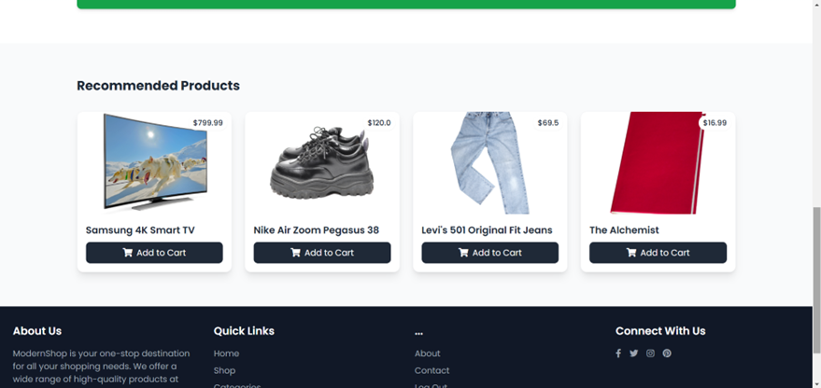
5. Finalize Recommendation Engine
Ensured that the recommendation an engine gives produces personal recommendations for products.

Slide 26
Challenges and Solutions Across Phases
Scalability Issues During High Traffic:
Solution: Implemented processes to cache references and properly optimize of the database queries to deal with the large loads.
Integration Errors with Payment Gateways:
Solution: Step by step discussed and worked at improved error handling routines with more detailed focus on various transaction types.
UI Complexity Based on User Feedback:
Solution: Modified main toolbar and toolbars of subscreens in order to make an access to different functions more convenient for users and raise their mood during work.
Synchronization Delays in Cart Updates:
Solution: Simplified PROPER operations behind the scenes for matched real-time cart activity with inventory.

Slide 27
Reflections and Future Work
Reflections:
Project coordination made the development of any feature a group effort and integration was well achieved at all stages.
It increased the general periodicity of tests and helped keep the platforms under test more stable and closer to the users.
Future Work:
Improve the recommendation engine even more employing the personalization and the data analysis from Artificial Intelligence.
Make ui /ux design for handicap/ disabled persons so as to increase the platform’s diversity.
Introduce enhancements of the backend architecture for vast growth of the support to multiple vendor platforms from many tenanted clients.
Implement predictive analysis to identify the user’s expectation to plan the inventory effectively.

